Slide 1

Digital Logic Design

Slide 2
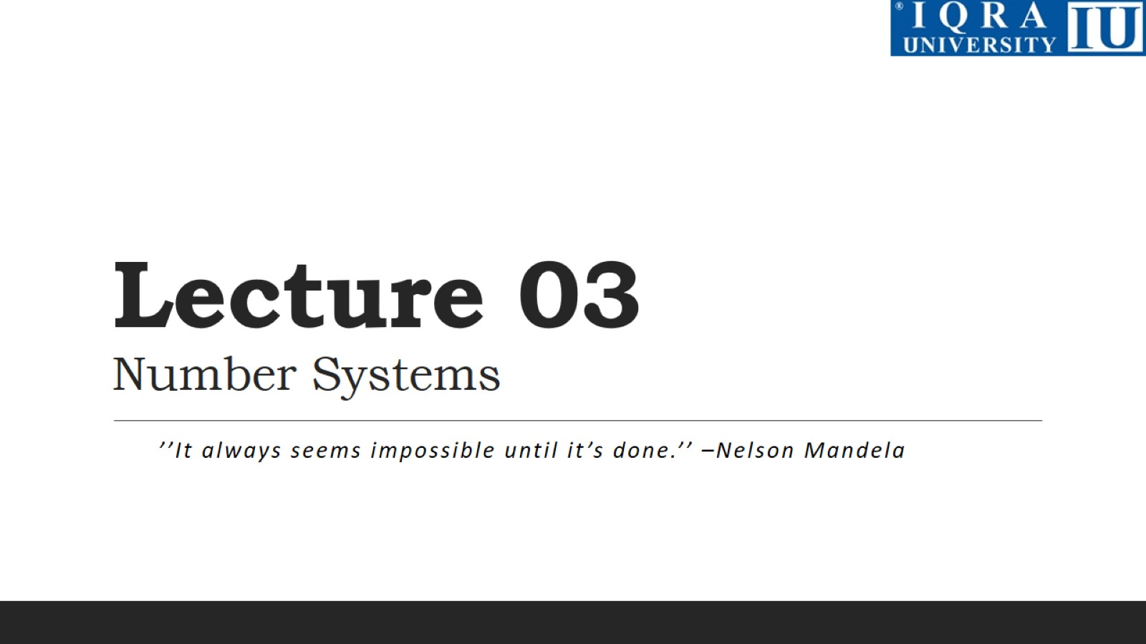
Lecture 03 Number Systems

Slide 3
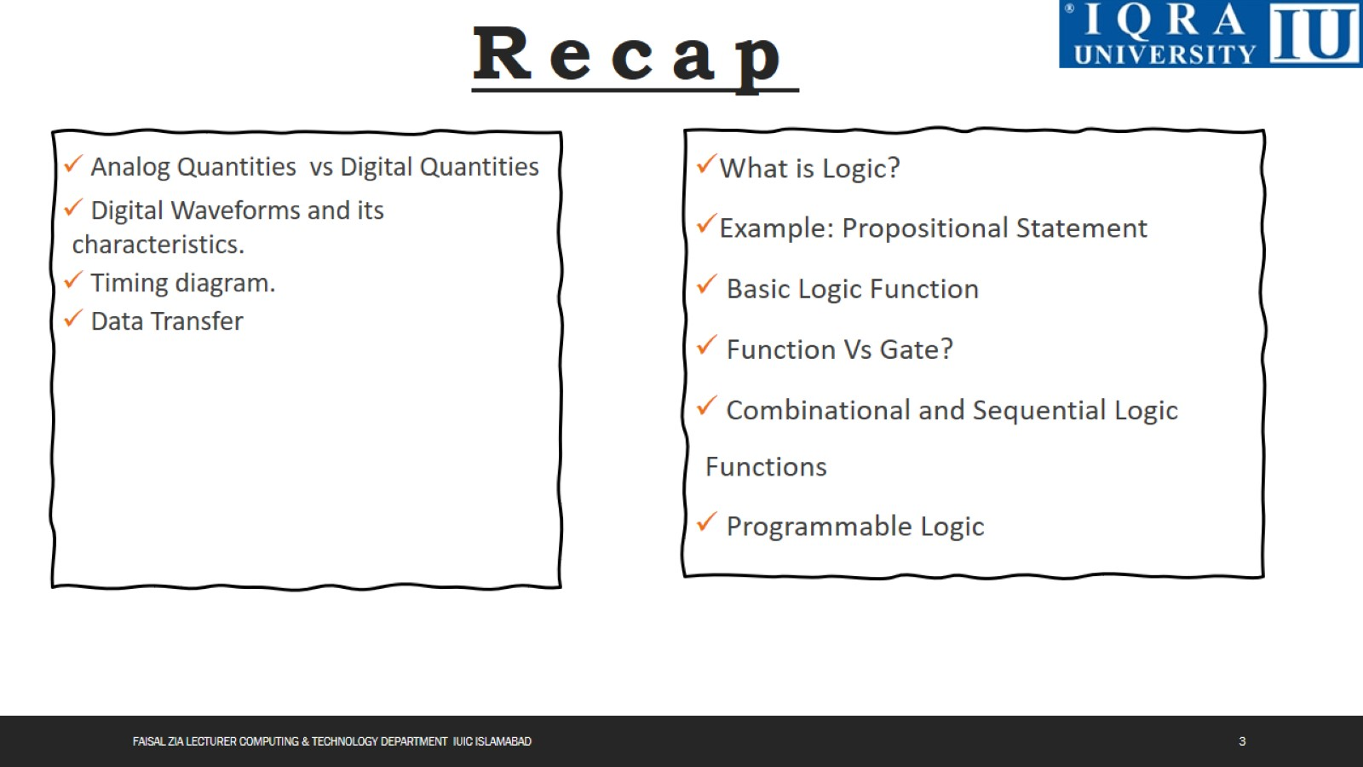

Slide 4
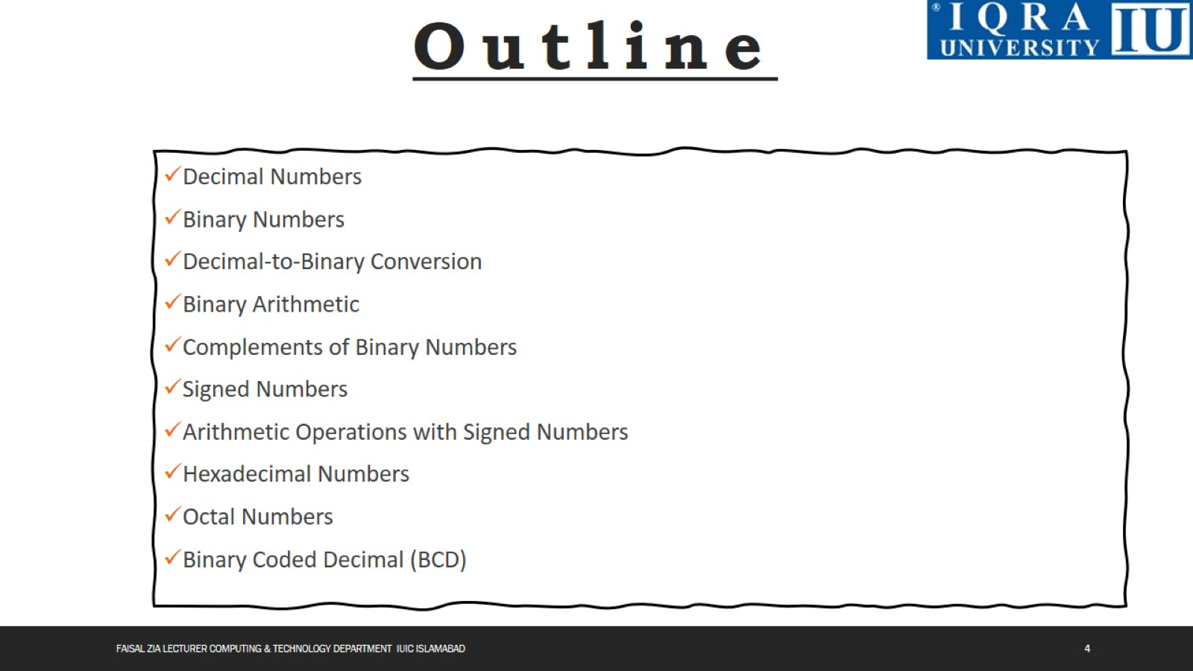

Slide 5
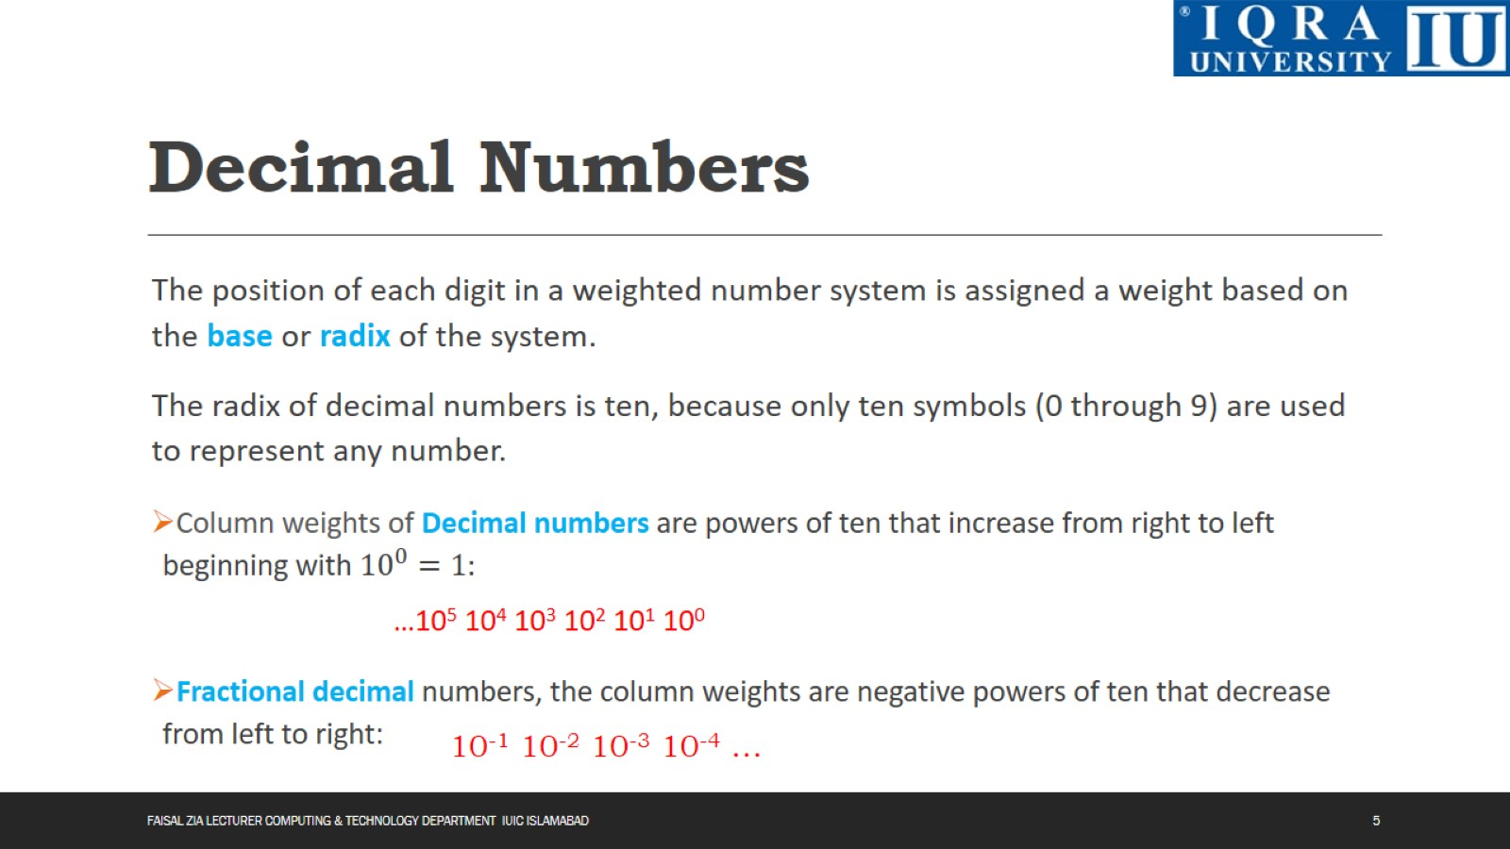
Decimal Numbers

Slide 6
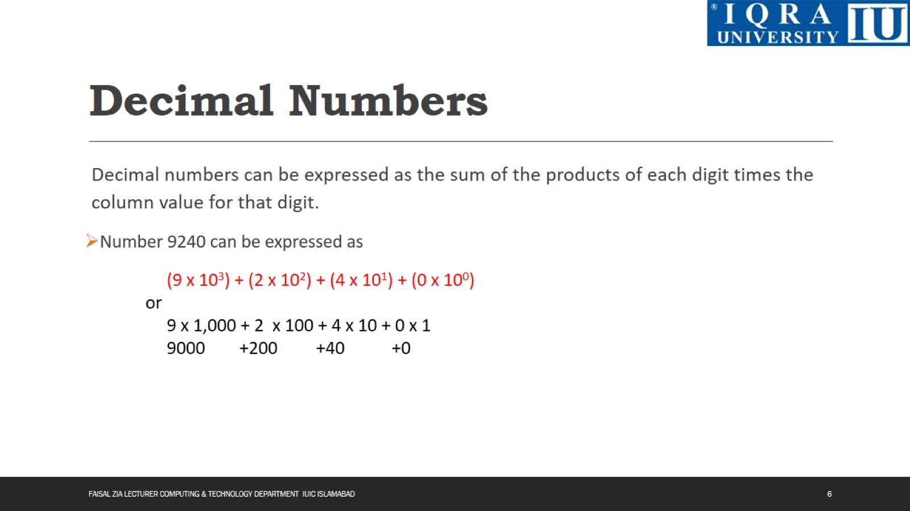
Decimal Numbers

Slide 7
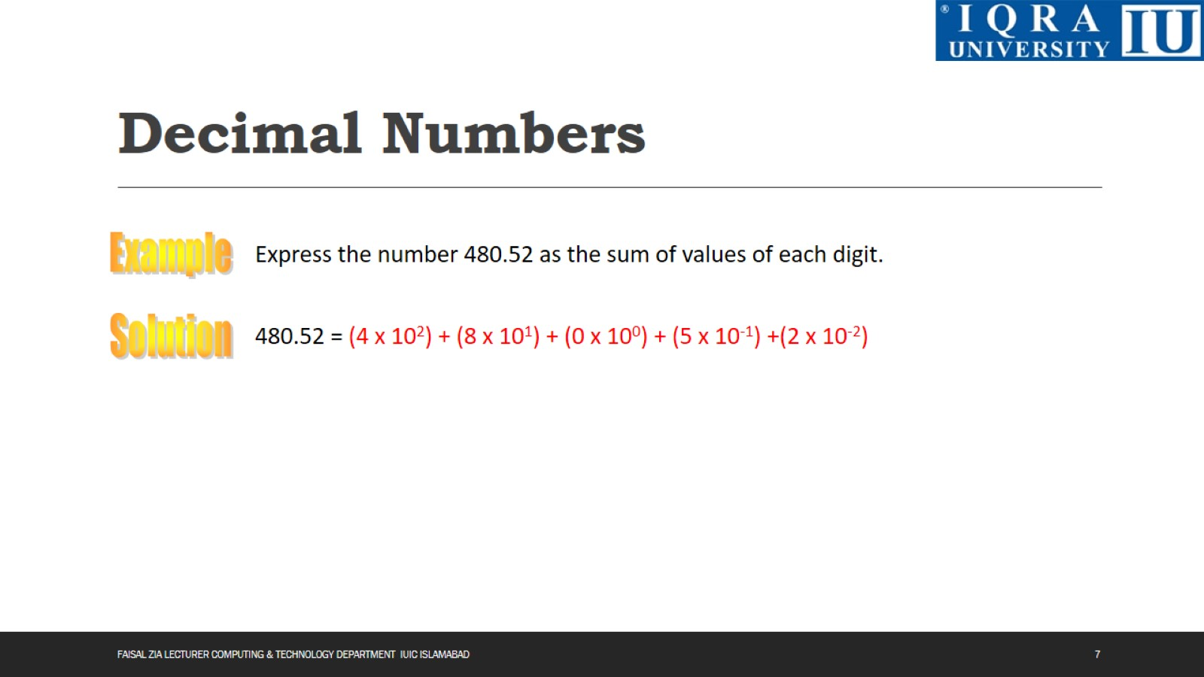
Decimal Numbers

Slide 8
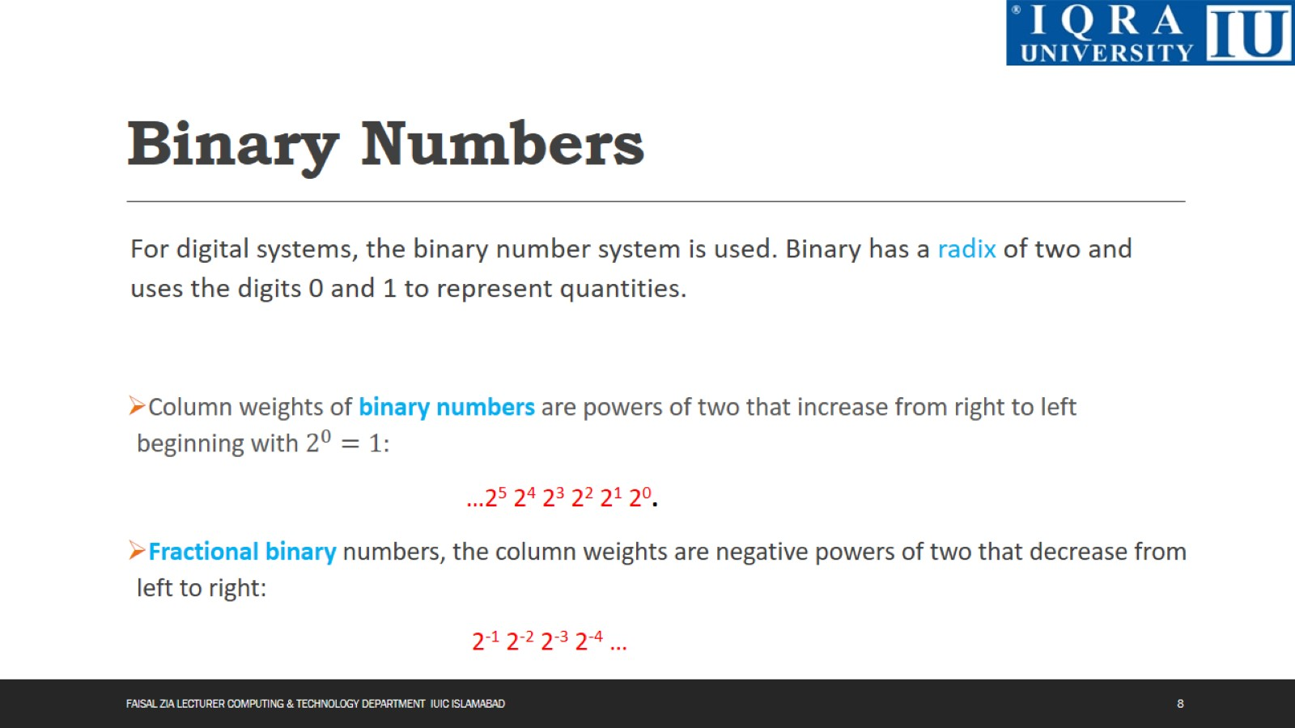
Binary Numbers

Slide 9
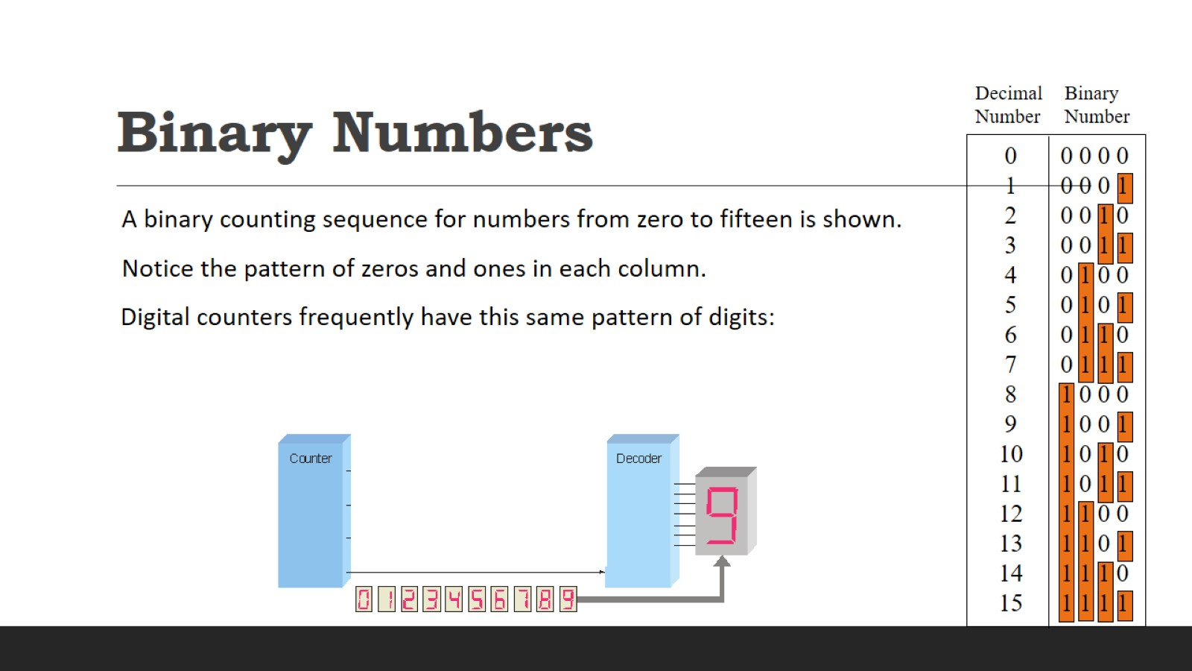
Binary Numbers

Slide 10
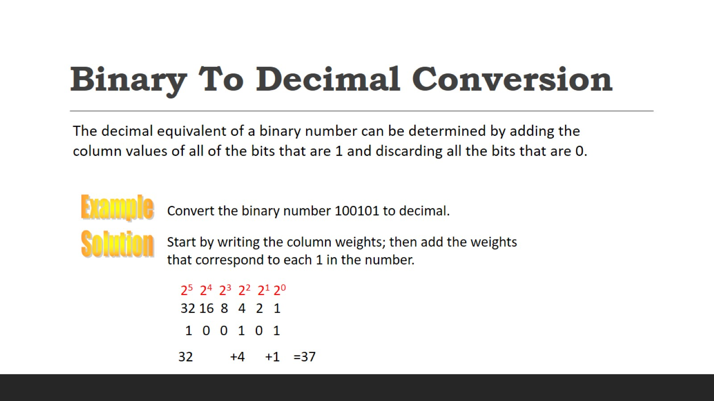
Binary To Decimal Conversion

Slide 11
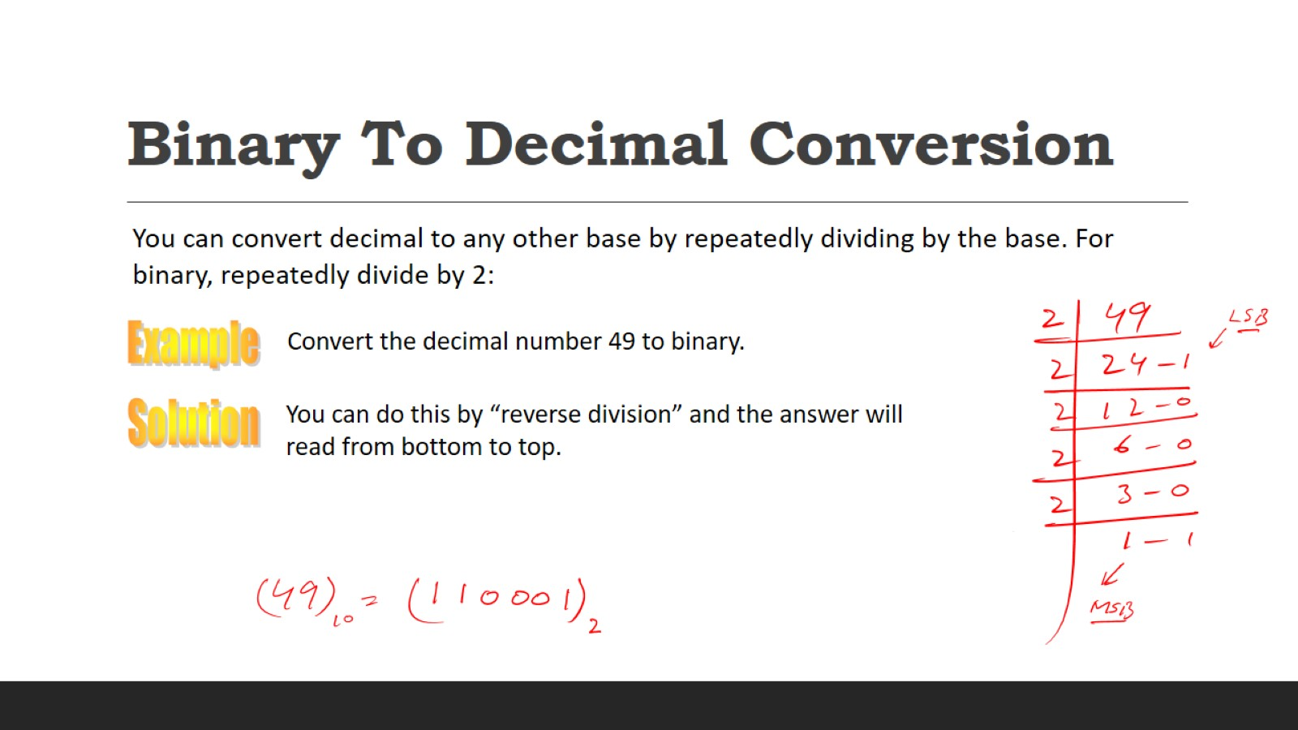
Binary To Decimal Conversion

Slide 12
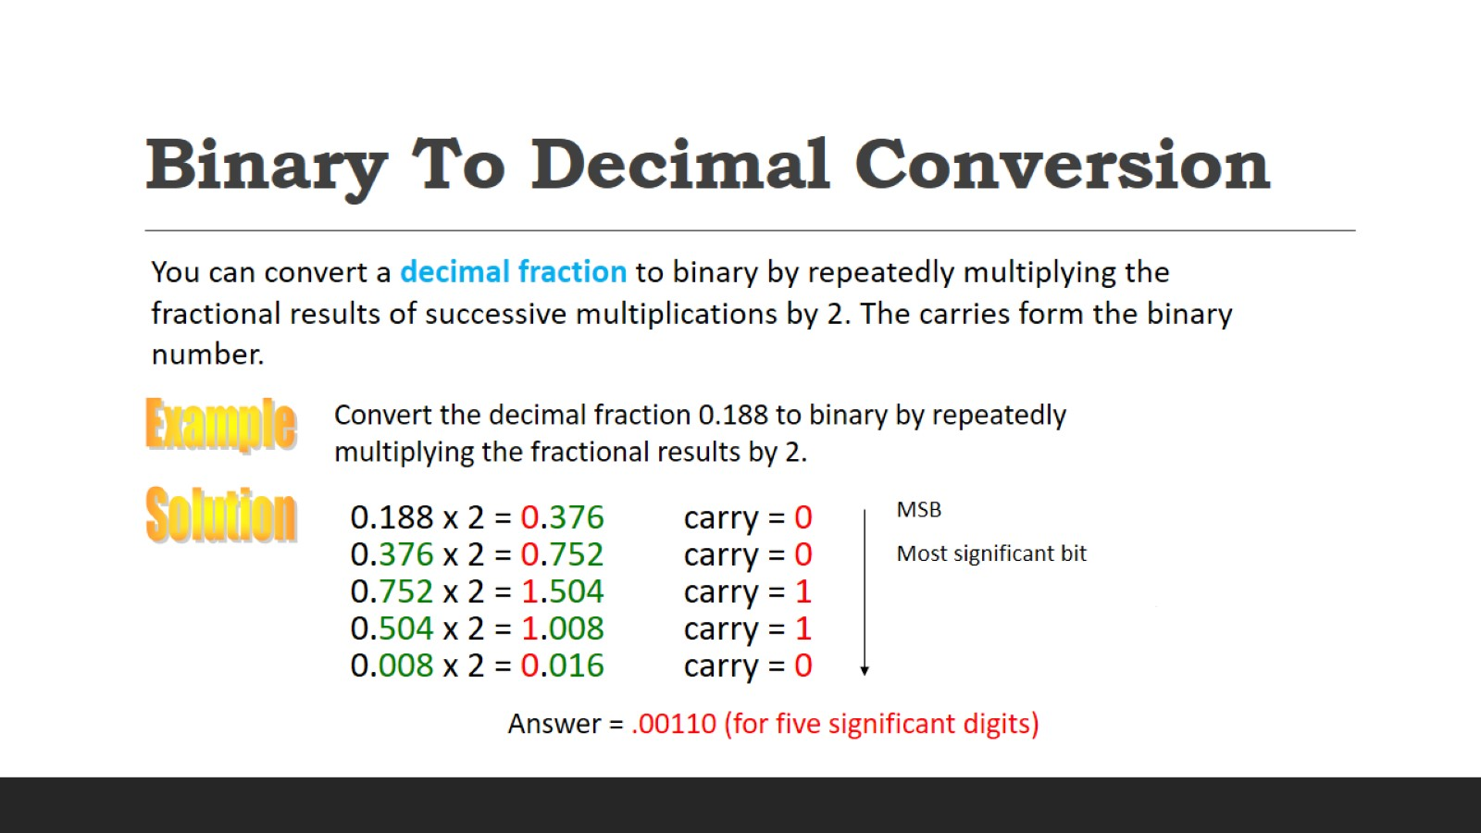
Binary To Decimal Conversion

Slide 13
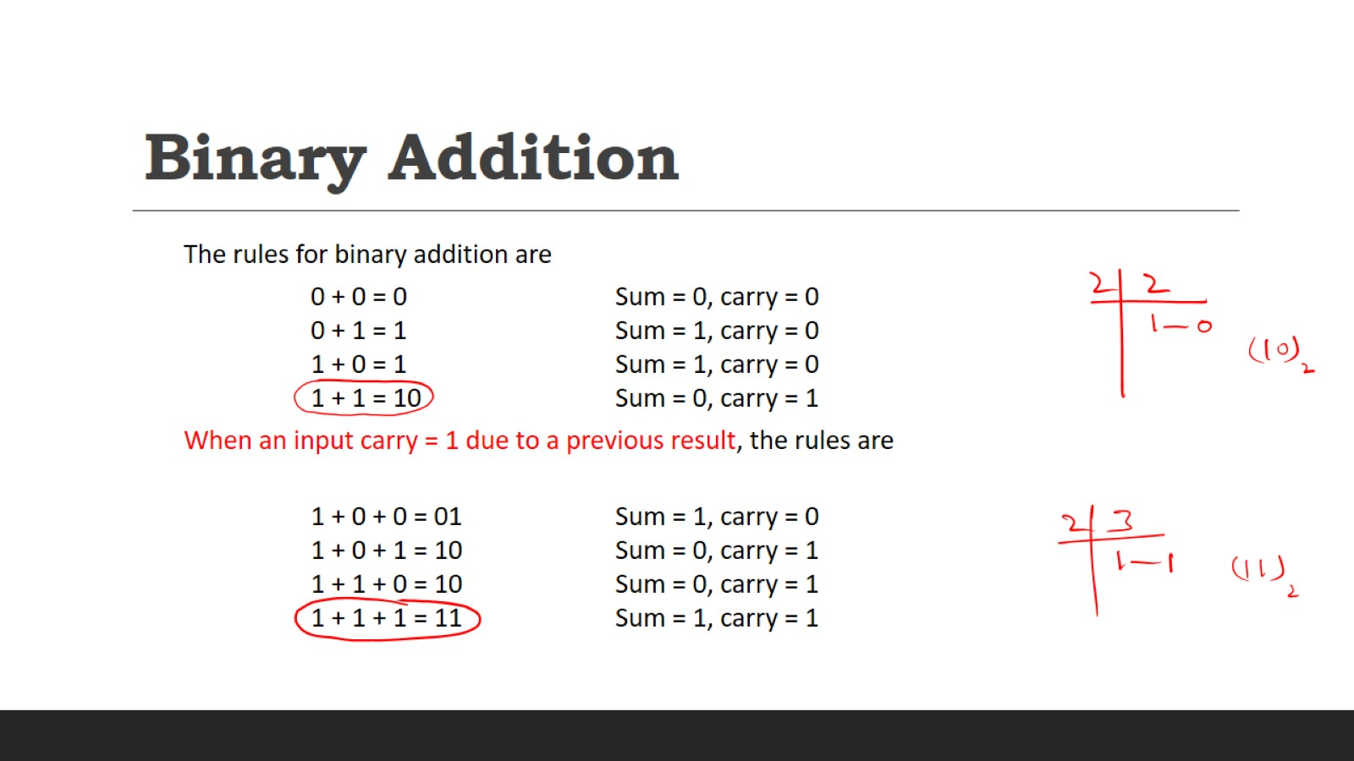
Binary Addition

Slide 14
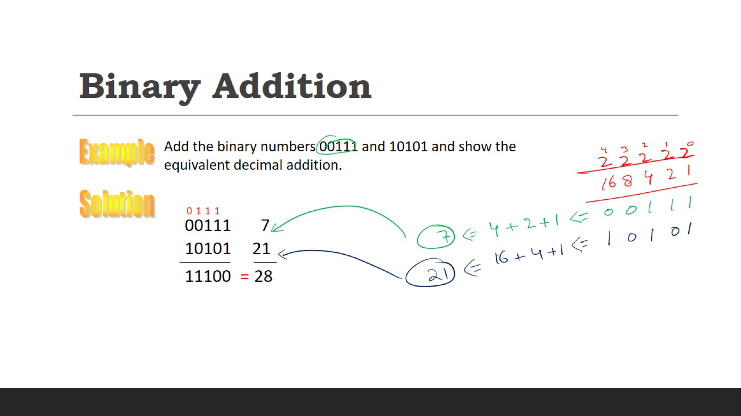
Binary Addition

Slide 15
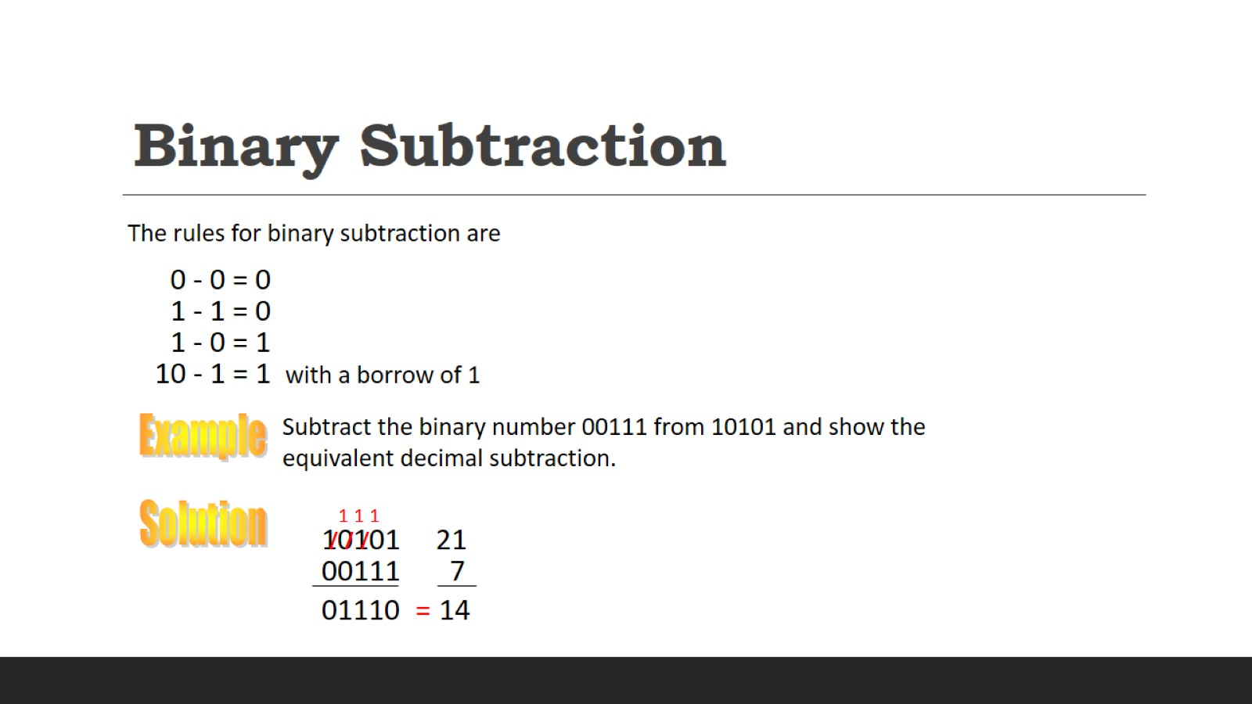
Binary Subtraction

Slide 16
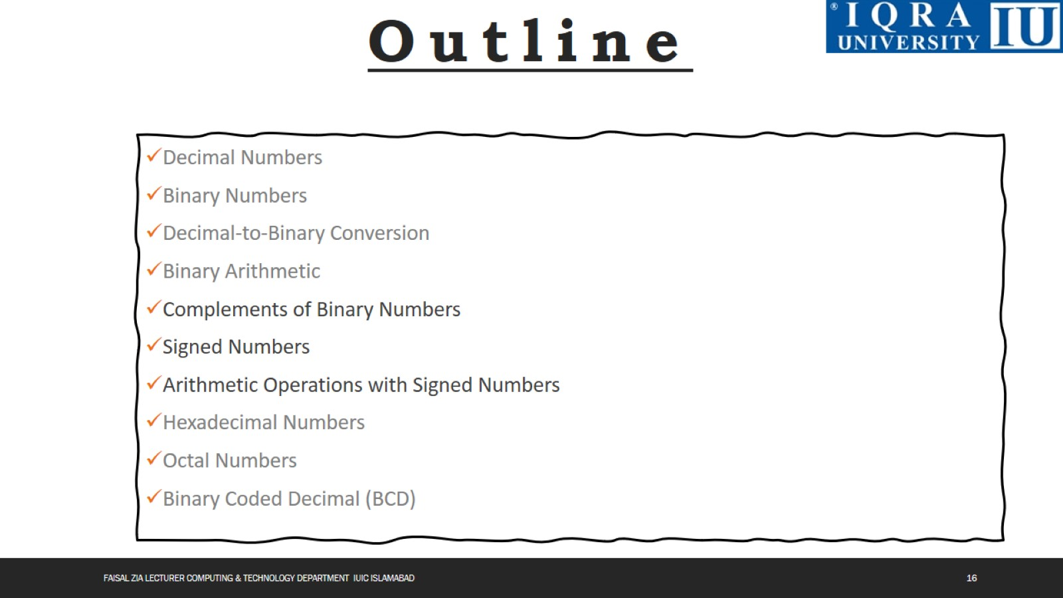

Slide 17
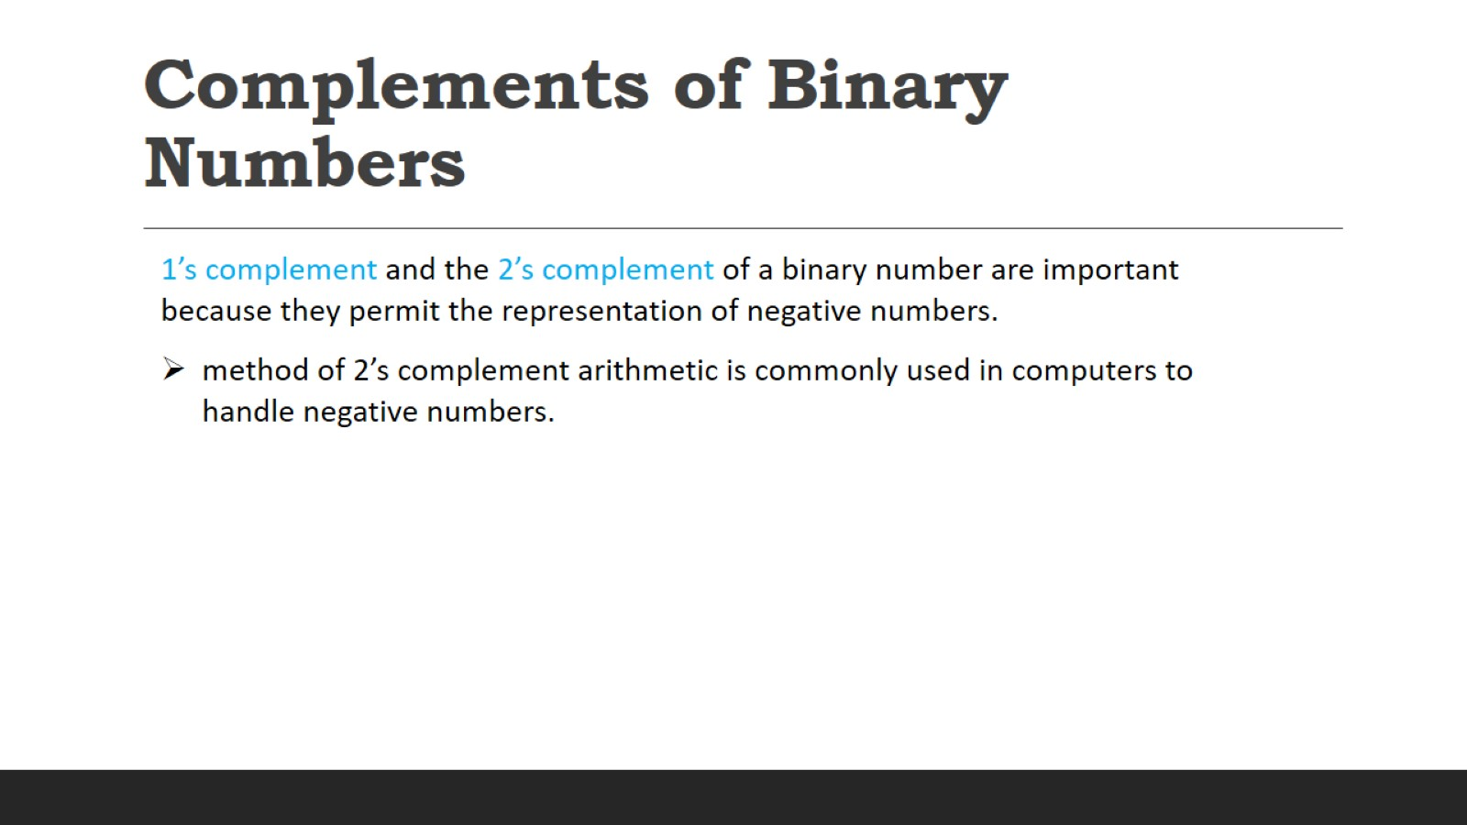
Complements of Binary Numbers

Slide 18
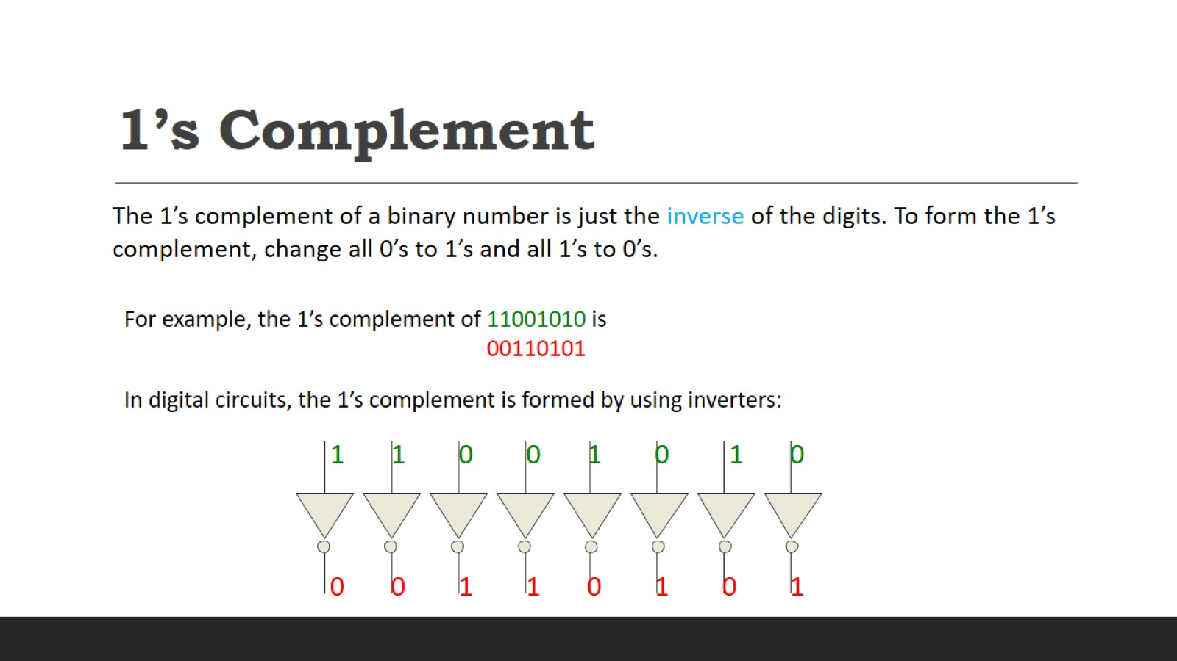
1’s Complement

Slide 19
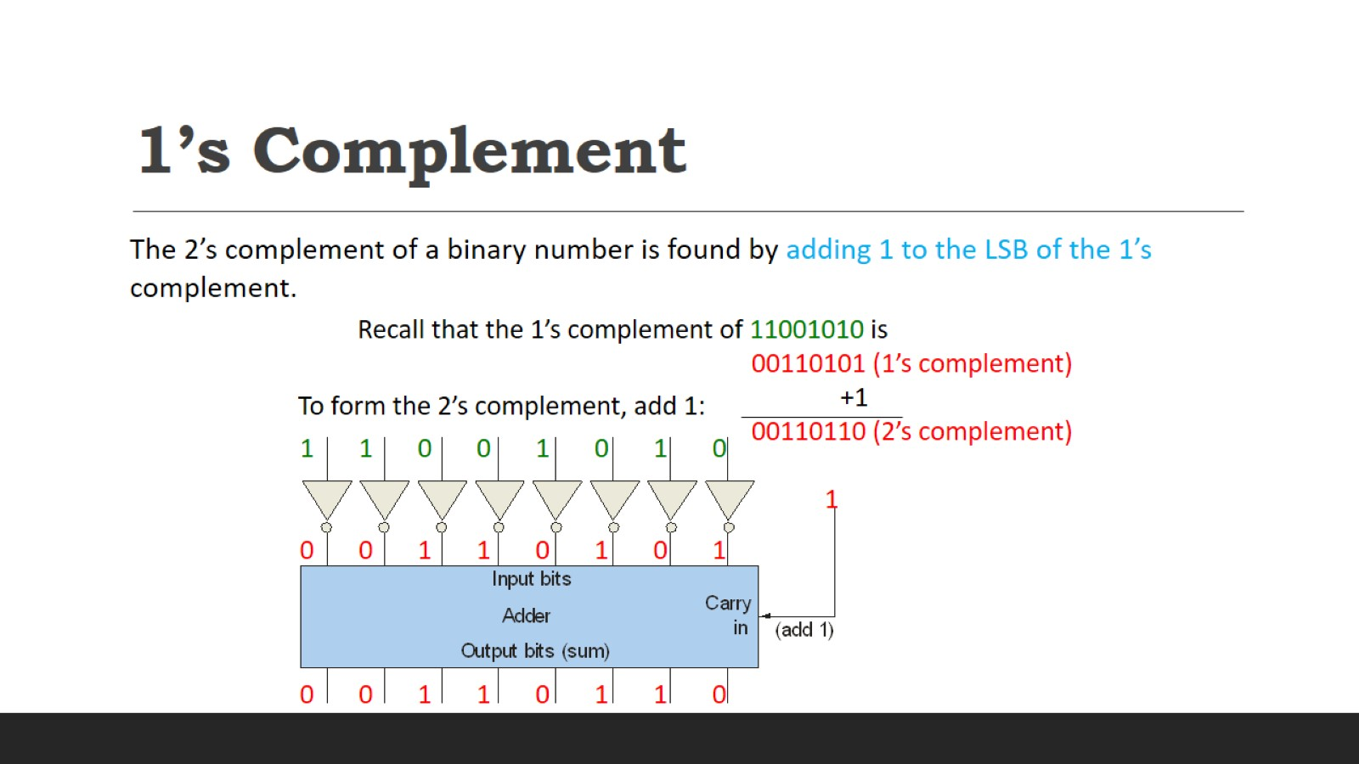
1’s Complement

Slide 20
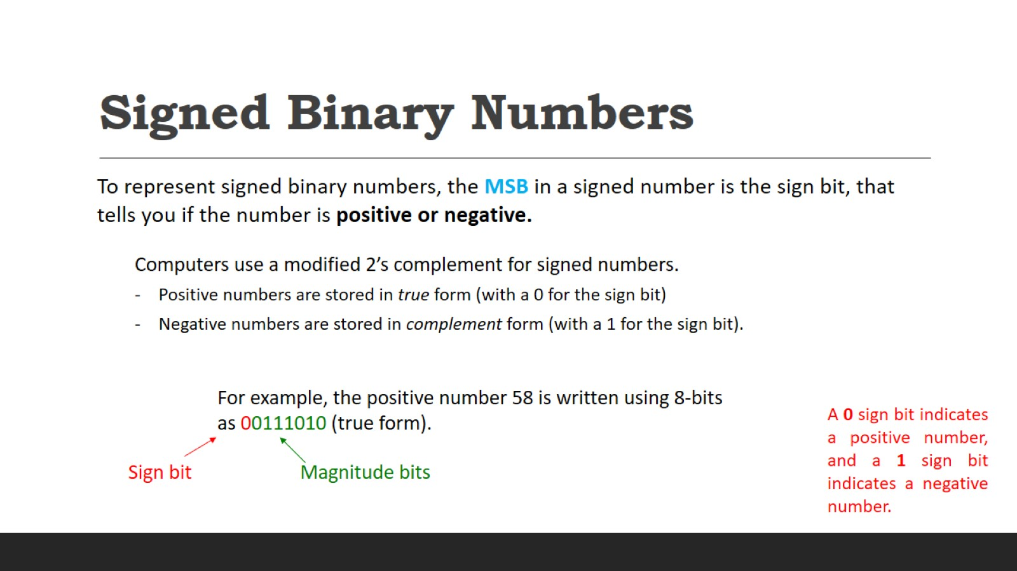
Signed Binary Numbers

Slide 21
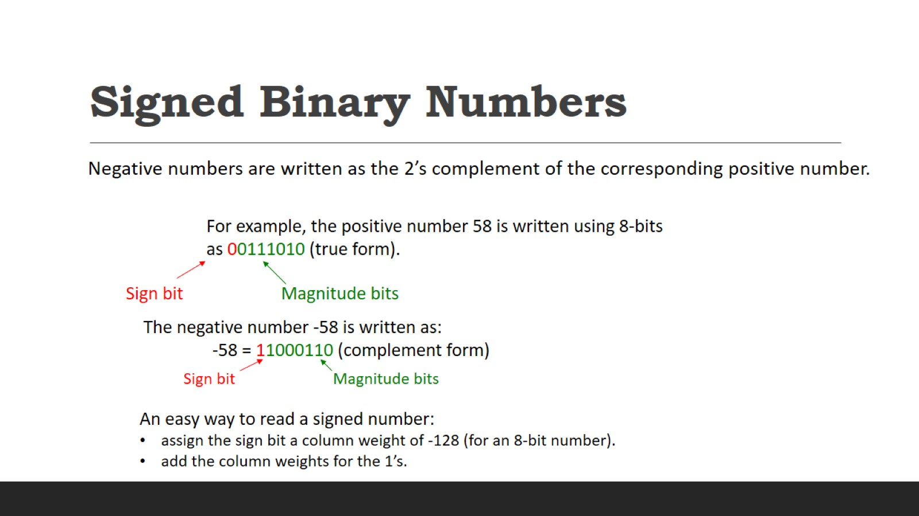
Signed Binary Numbers

Slide 22
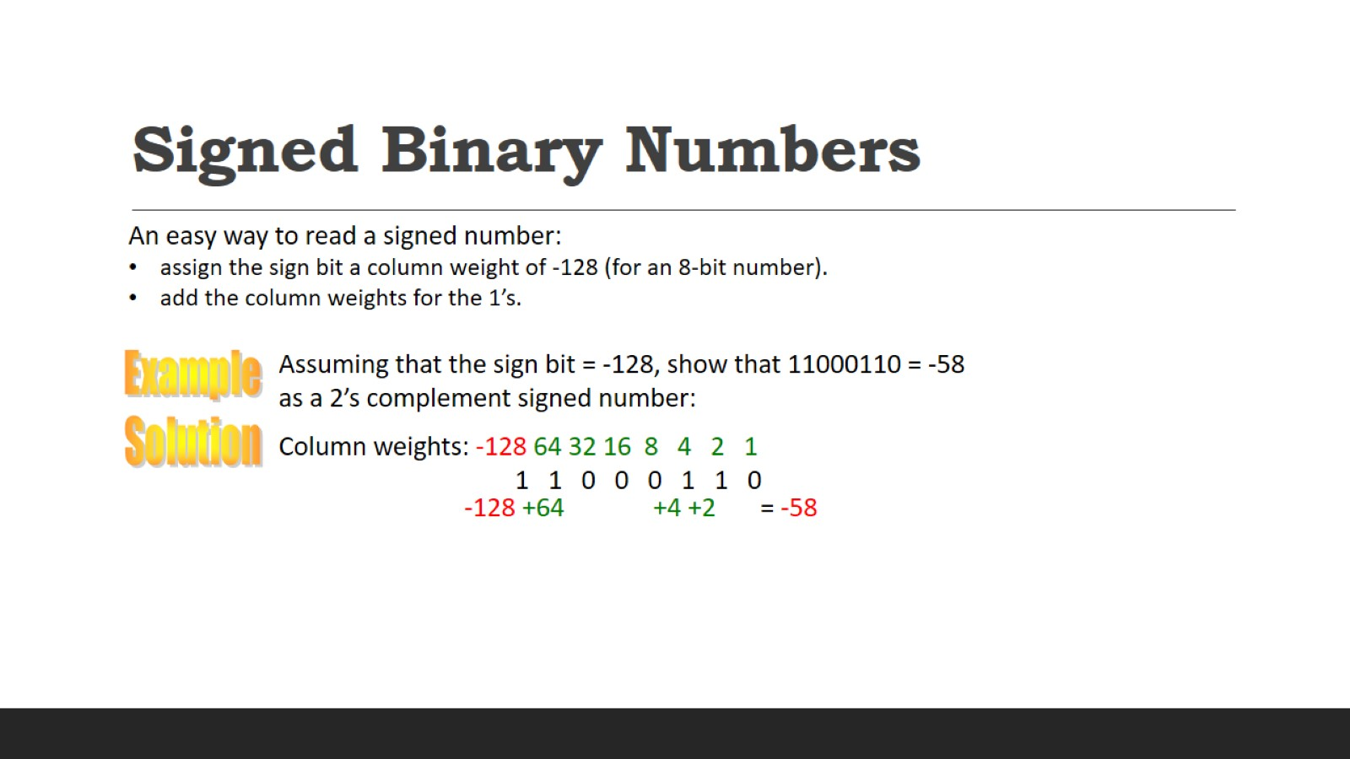
Signed Binary Numbers

Slide 23
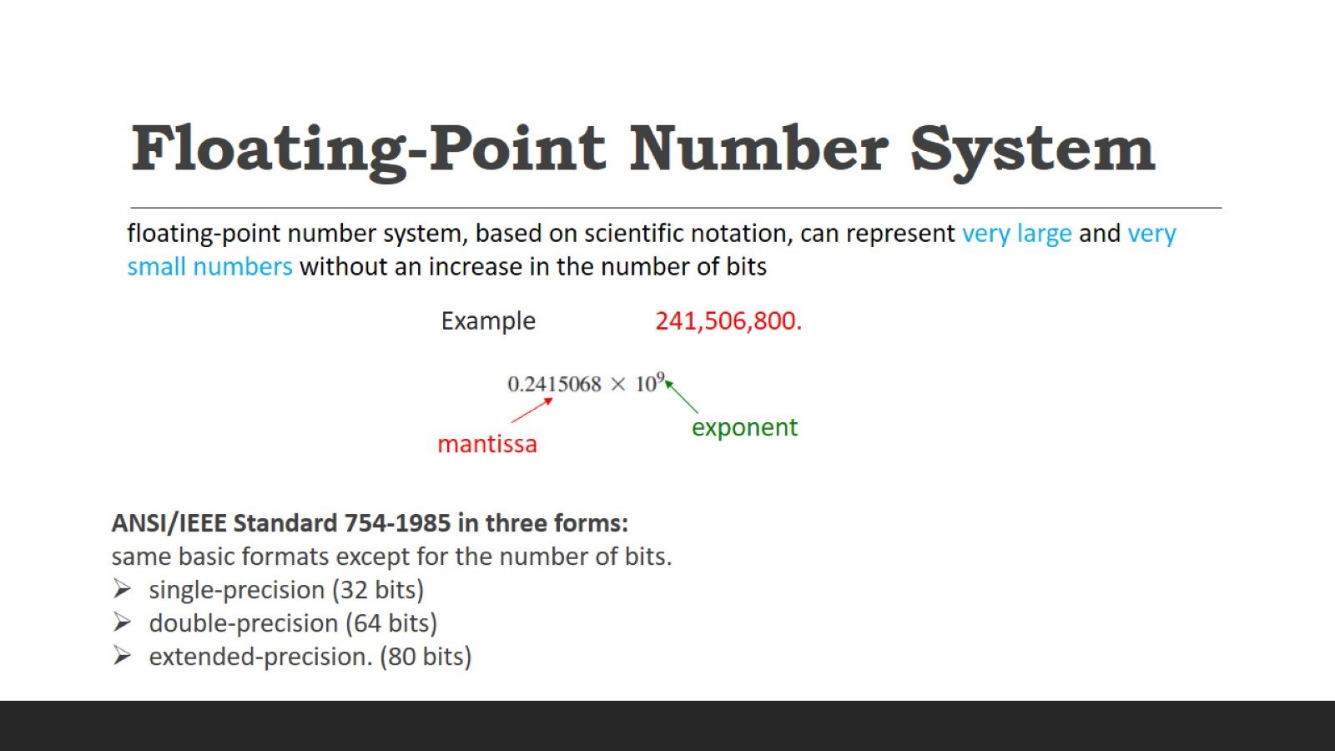
Floating-Point Number System

Slide 24
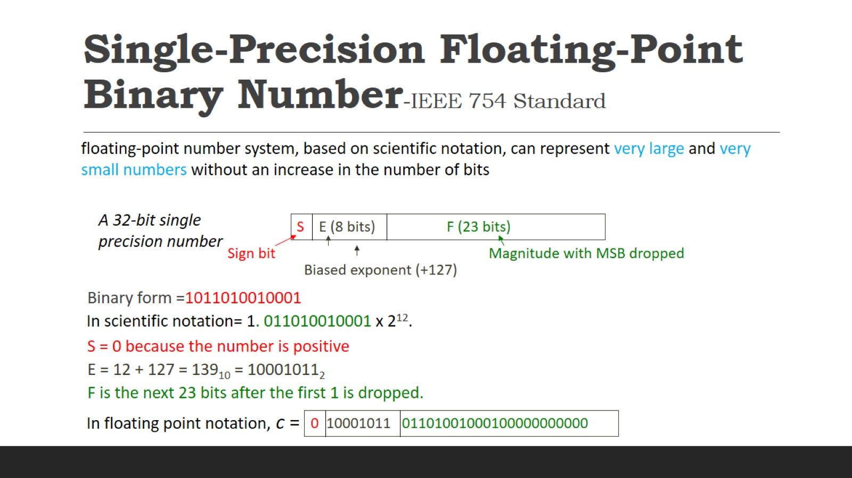
Single-Precision Floating-Point Binary Number-IEEE 754 Standard

Slide 25
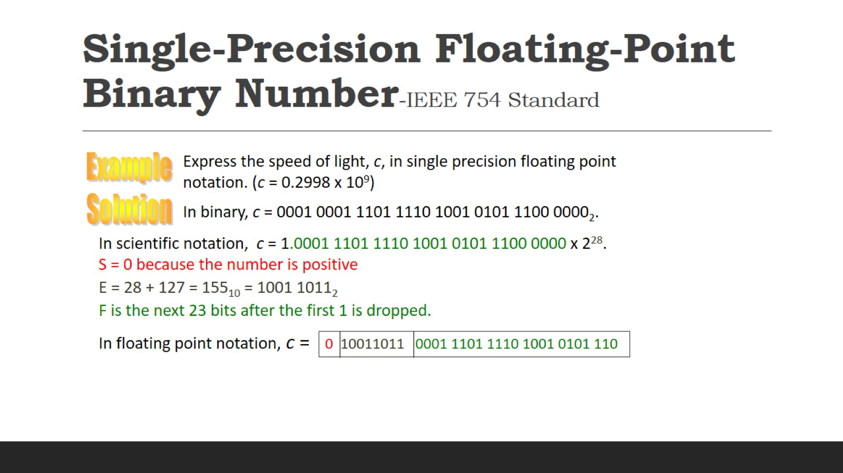
Single-Precision Floating-Point Binary Number-IEEE 754 Standard

Slide 26
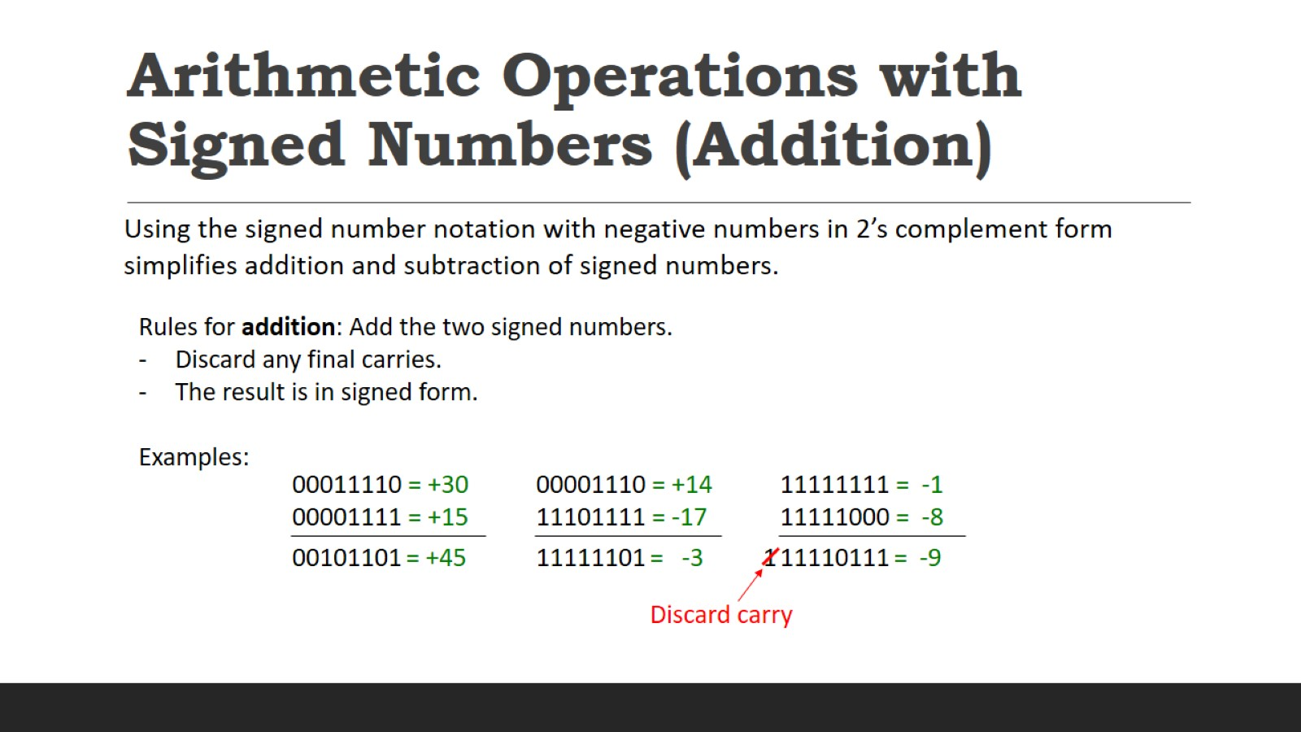
Arithmetic Operations with Signed Numbers (Addition)

Slide 27
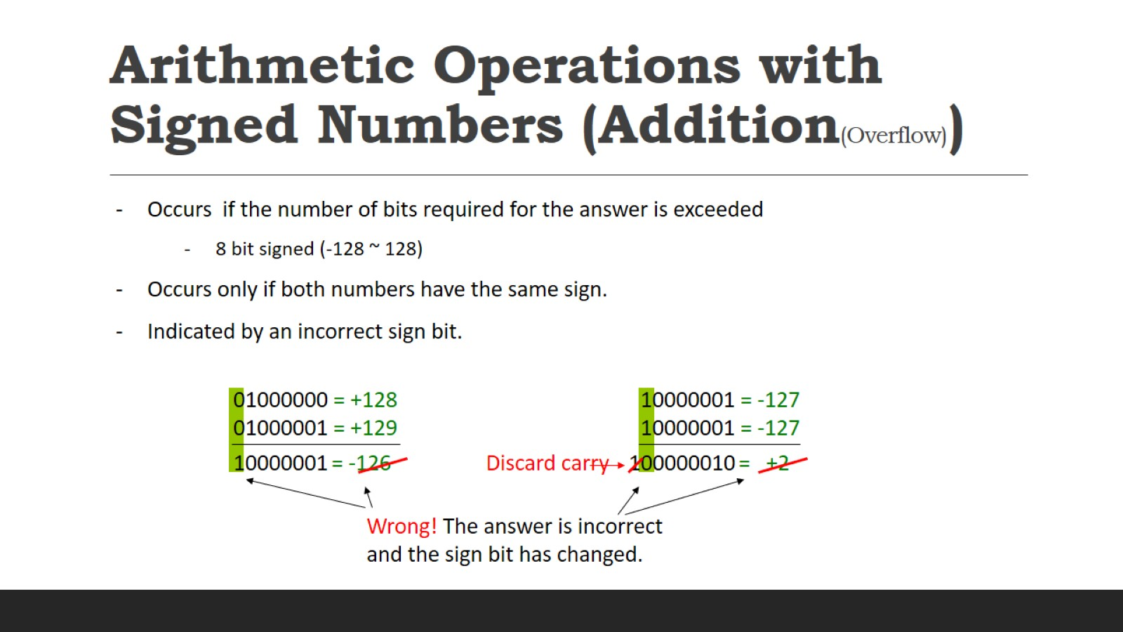
Arithmetic Operations with Signed Numbers (Addition(Overflow))

Slide 28
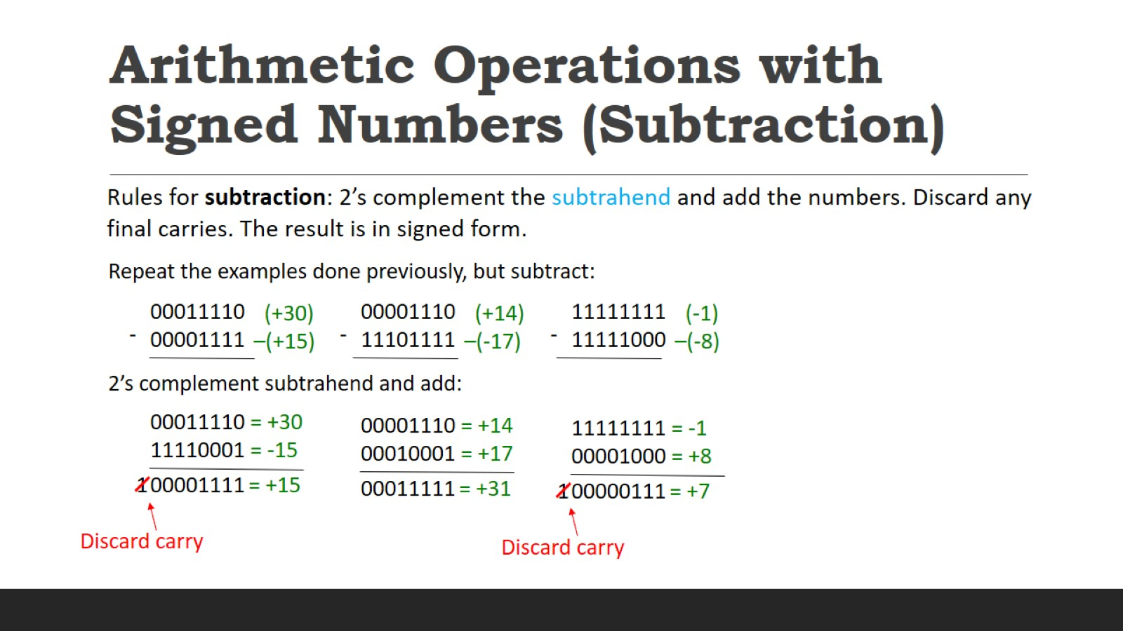
Arithmetic Operations with Signed Numbers (Subtraction)

Slide 29
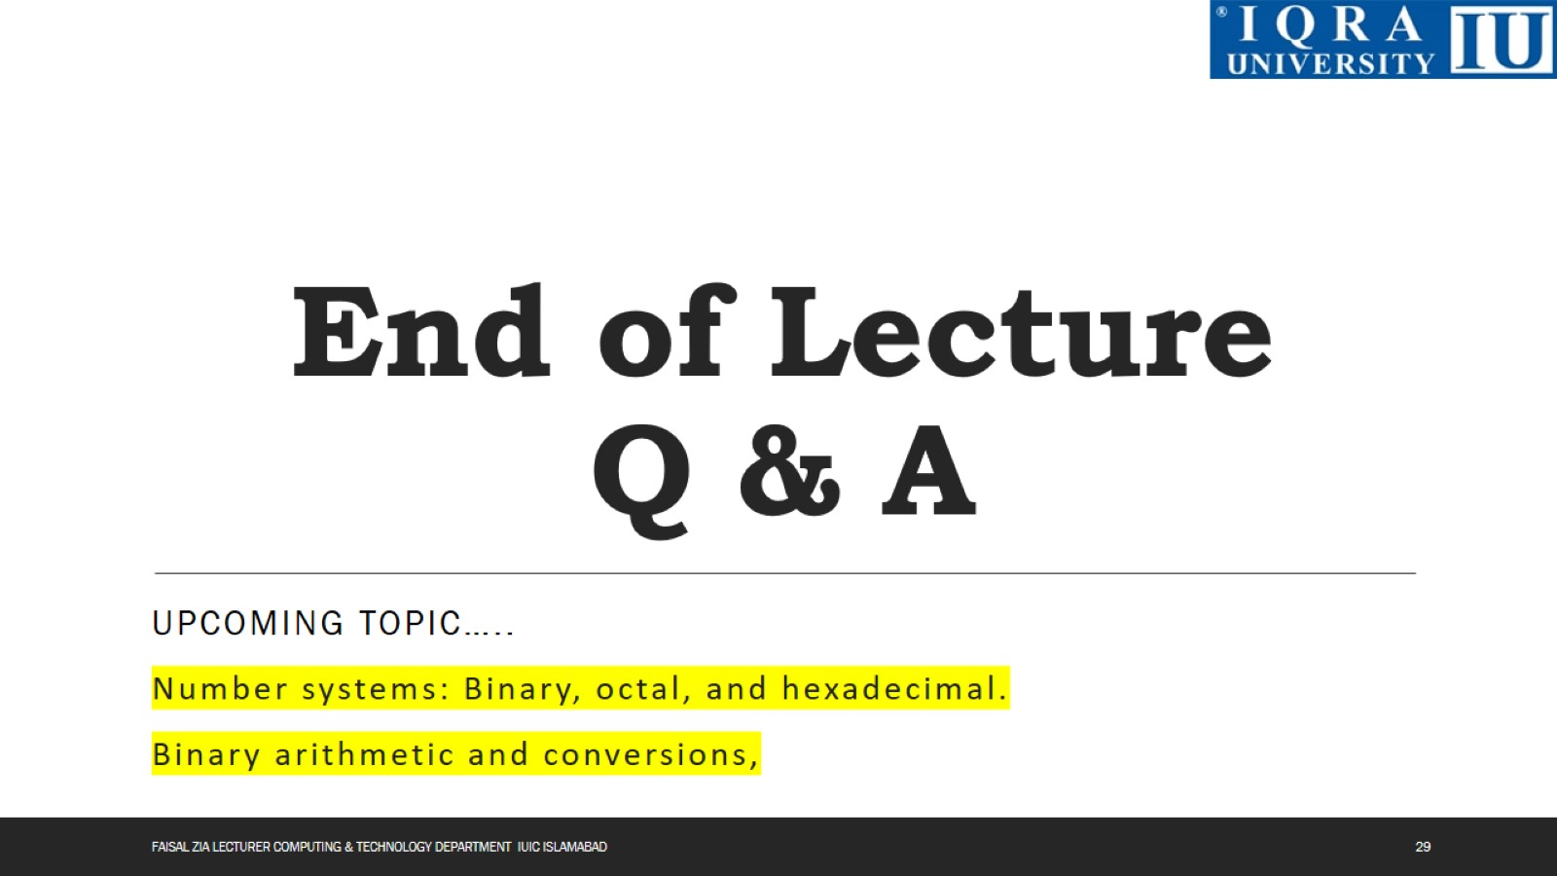
End of Lecture Q & A

